Slide 1
Data Security with Power BI, SSAS, SQL Server 2016 and Active Directory
June 10, 2017

Slide 2
Who am I
Hector Villafuerte
Business Intelligence Architect at Starwood Property Trust
Microsoft Certified Technology Specialist, SQL, Dynamics CRM - MCTS
Works with SQL Server, Excel, Power BI, SSIS, SSAS, SSRS, SharePoint, Dynamics CRM and Azure PAAS.
Microsoft Certified Professional Developer – MCPD
Full-stack .NET Developer and Web Applications Architect.
Reach me at:
Twitter - @optimumclick
http://www.hectorv.com
optimumclick@gmail.com

Slide 3
Data Security with Power BI, SSAS, SQL Server and Active Directory
Agenda
SQL Server 2016 On-Premise Data Security with Active Directory
SSAS Tabular/Multidimensional Security with Active Directory
Azure Active Directory and On-Premise Gateway
Power BI Data Security – Live Connection SSAS Tabular/Multidimensional with Active Directory
Power BI Data Security – Imported DataSet and Direct Query - with Active Directory
Client Apps with RLS and Power BI RLS integration with a web application.

Slide 4
Survey
How many of you are using Active Directory in your company?
How many of you are using SSAS Tabular or Multidimensional?
How many of you are using PowerBI in your company?

Slide 5
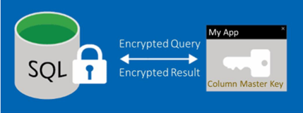
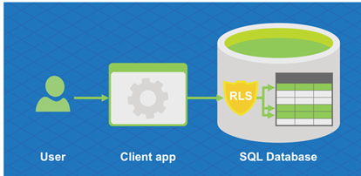
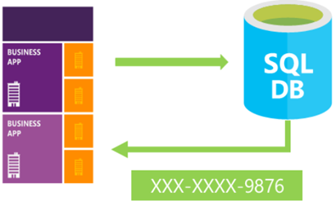
New SQL Server 2016 security features
Always Encrypted: motion
Row-Level Security
Dynamic Data Masking
Security
Notes:
Always Encrypted enables encryption inside client applications without revealing encryption keys to SQL Server. It allows changes to encrypted data without the need to decrypt it first, as shown in Figure 3. The combination of Transparent Data Encryption and Always Encrypted ensures that data is encrypted both at rest and in motion.
Row-Level Security (RLS), which Figure 4 illustrates, enables developers to centralize row-level access logic in the database and maintain a consistent data access policy to reduce the risk of accidental data leakage.
Dynamic Data Masking (DDM) lets you conceal your sensitive data or personally identifiable information (PII) such as customer information such as phone number, bank information, or Social Security number. DDM and Row-Level Security (RLS) help developers build applications that require restricted direct access to certain data as a means of preventing users from seeing specific information.
Limitations during the preview:
RLS is incompatible with database export using Data Tier Application Framework (DACFx). You must drop all RLS policies before exporting.
Security policies cannot target views.
Certain query patterns using OR logic can trigger un-optimized table scans, decreasing query performance.
No syntax highlighting in SQL Server tools.

Slide 6
Row Level Security – Use Cases
Oil & gas exploration app might restrict access to well production data, based on analyst’s region.
Healthcare app might restrict access to patient data, based on a doctor’s staffing assignments.
Multitenant app with a “shared database, shared schema” tenancy model needs to prevent tenants from accessing data that does not belong to them.
Real Estate app might restrict information to the investment department until the data is allowed to be published.

Slide 7
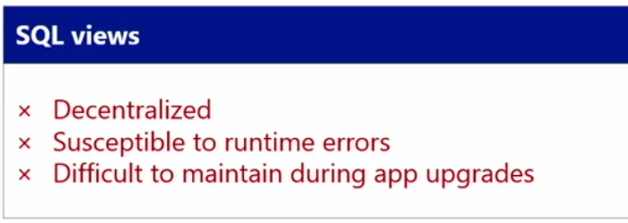
Row Level Security Traditional Solutions have problems

Slide 8
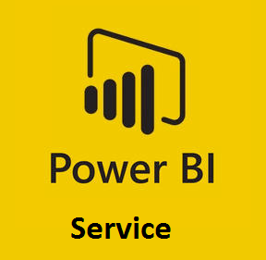
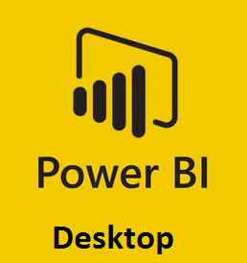
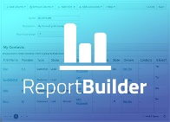
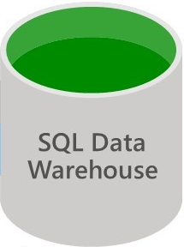
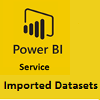
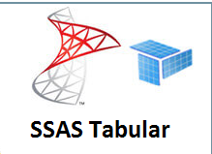
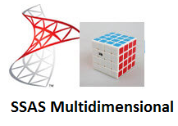
Security across many BI Tools and many databases
BI Tools
Consume interactive reports, queries
Import Data, Data Refresh
Databases
Notes:
Different users access same database through various reporting tools, and work with different subsets of data based on their identity/role

Slide 10
SQL Server 2016 - Row-Level Security
dbo.DimCustomer
Name
Country
Security Policy
Robin Alvarez
United Kingdom
Emily Miller houCorp.
United States
Cara Zhou
Germany
Policy Manager / DBA
SELECT *
FROM DimCustomer
United States
User: GHowell
SELECT *
FROM DimCustomer
APPLY GeographyAccessPredicate()

Slide 11
DEMO 2.1:
SQL Server 2016 On Premise with Row-Level Security with Active Directory.

Slide 12
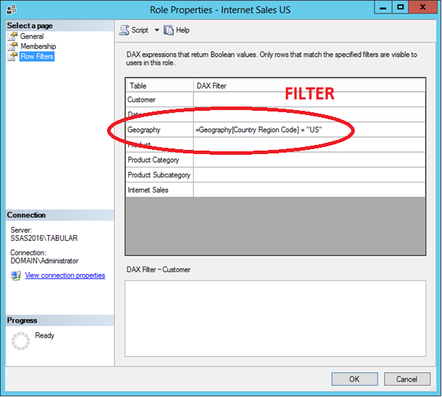
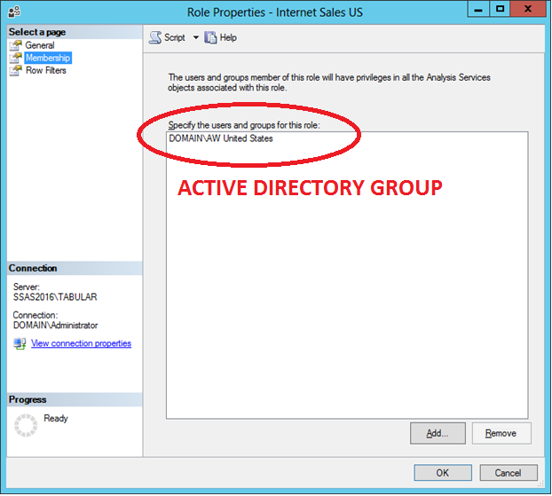
SSAS 2016 Tabular - Row-Level Security with Active Directory – On Premise.

Slide 13
DEMO 3:
SSAS 2016 Tabular On Premise with Row-Level Security and Active Directory.

Slide 14
Power BI and RLS On-Premise - Data Sources:
We need these two integration components:
- Azure AD Connect: Azure AD Connect will integrate your on-premises directories with Azure Active Directory. This allows you to provide a common identity for your users for Office 365, Azure, and SaaS applications integrated with Azure AD.
- On-Premise Data Gateway: The on-premises data gateway acts as a bridge, providing quick and secure data transfer between on-premises data (data that is not in the cloud) and the Power BI, Microsoft Flow, Logic Apps, and PowerApps services.

Slide 15
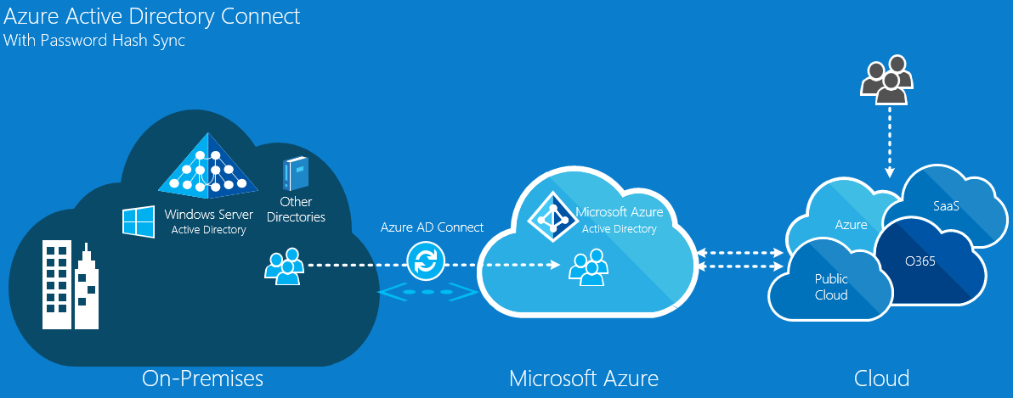
Active Directory Synch

Slide 16
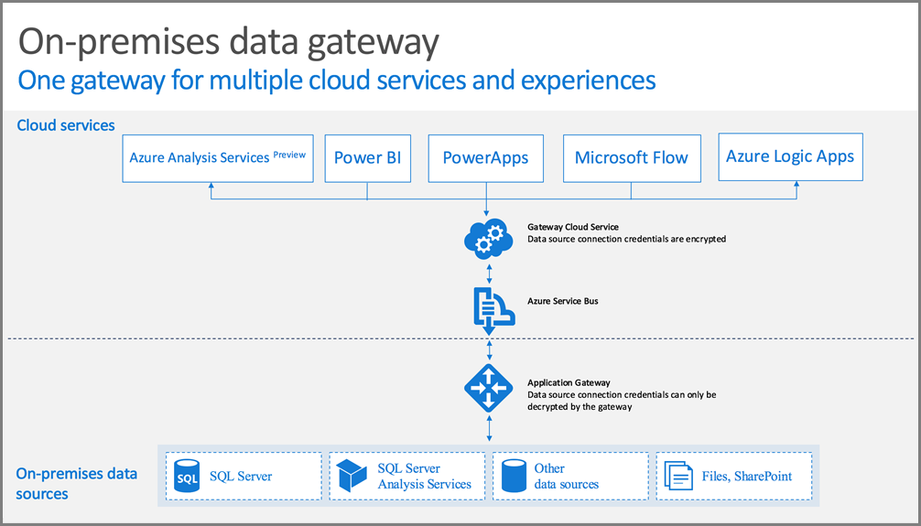
On-Premise Data Gateway

Slide 17
DEMO 4:
Power BI Security with Active Directory Synch and On-Premise Data Gateway

Slide 18
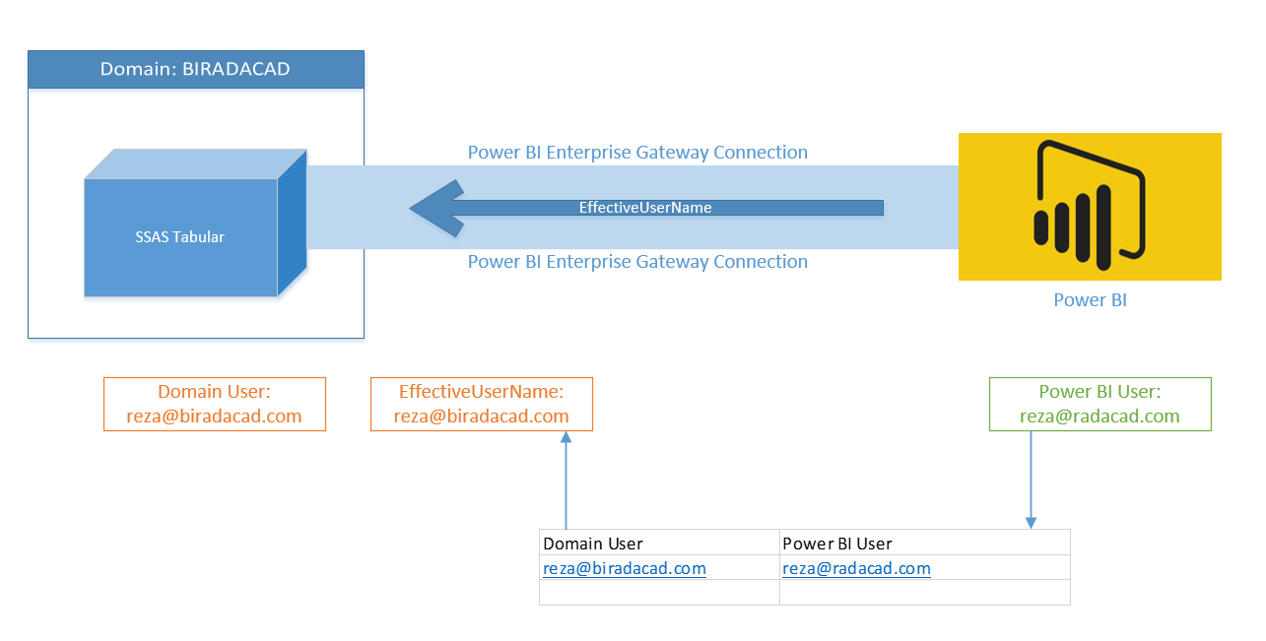
Row Level Security with SSAS Tabular Live Connection in Power BI
User Principal Name (UPN)

Slide 19
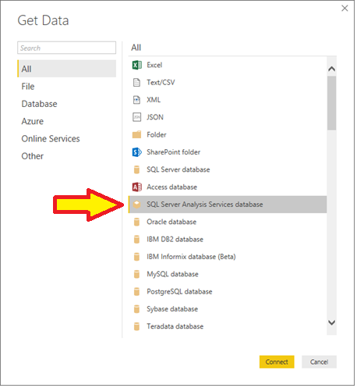
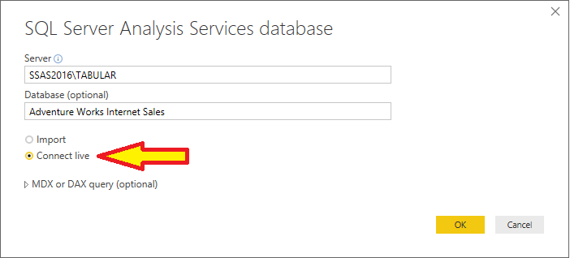
Power BI Desktop with SSAS Tabular Live Connection

Slide 20
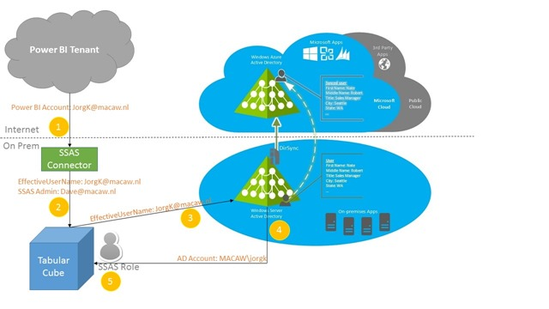
Row Level Security with SSAS Tabular Live Connection in Power BI

Slide 21
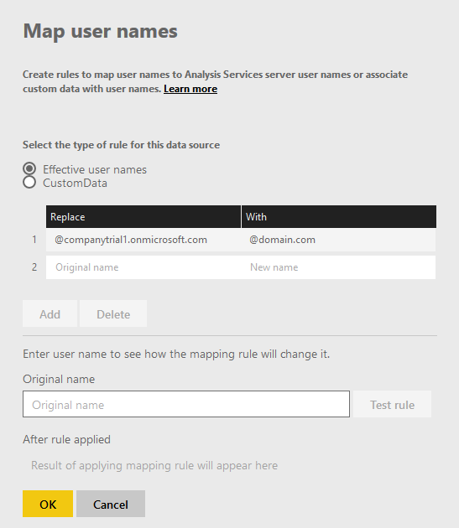
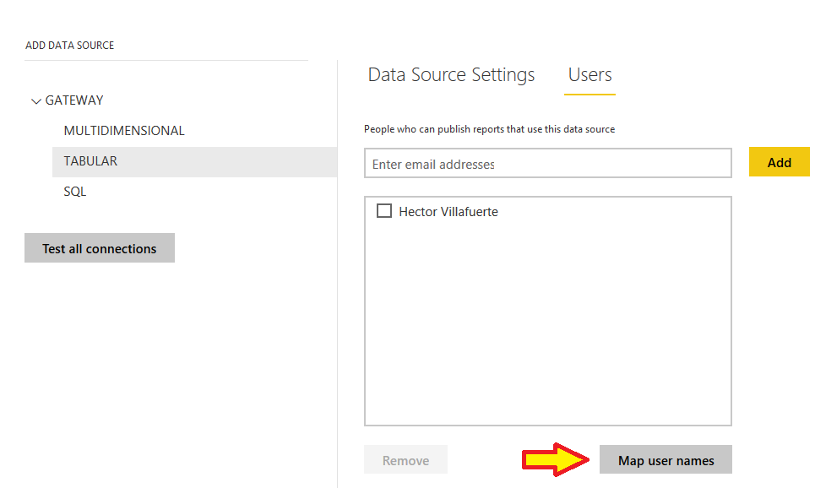
Row Level Security with SSAS Tabular Live Connection in Power BI

Slide 22
DEMO 5:
Power BI using SSAS Tabular with Row Level Security.
Power BI using SSAS Multidimensional with Row Level Security.

Slide 23
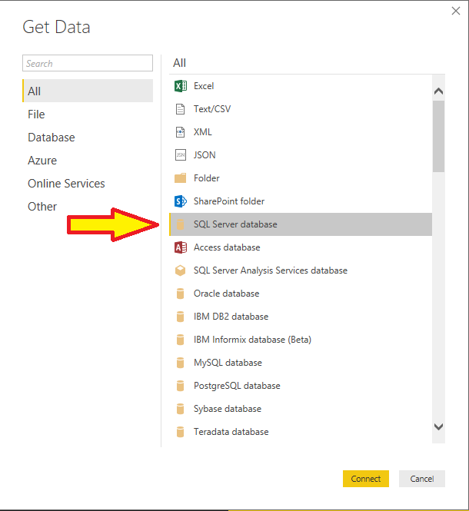
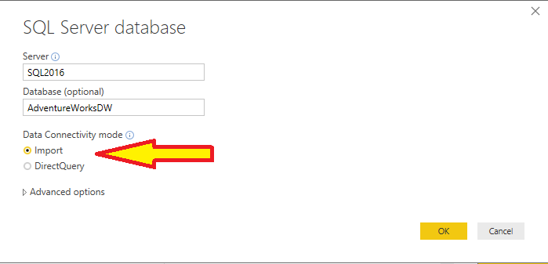
Power BI Desktop with SQL Server Imported Data or Direct Query

Slide 24
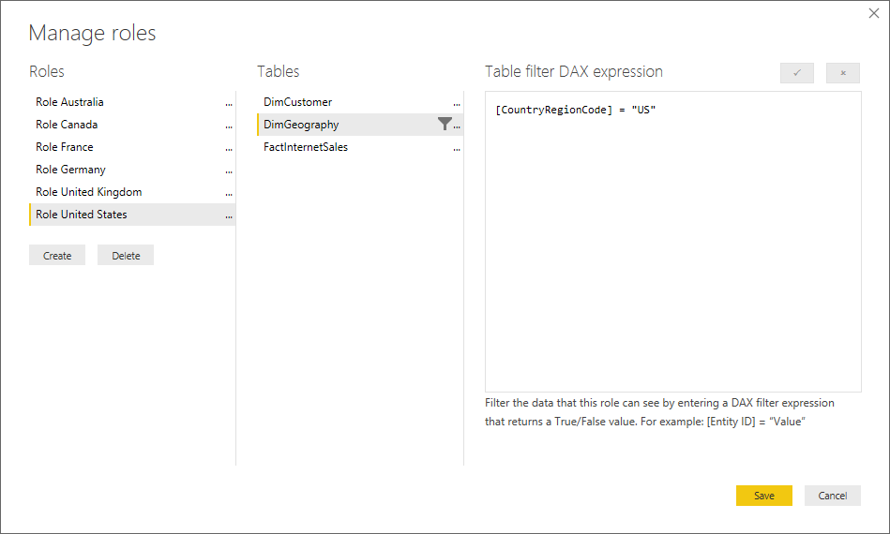
Power BI Desktop with SQL Server - Imported Data/Direct Query

Slide 25
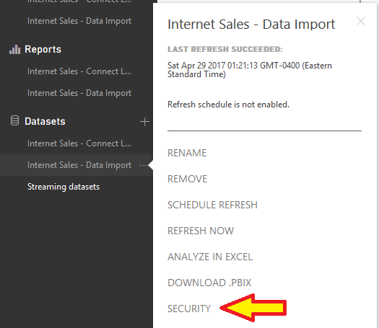
Power BI Service with Imported Data/Direct Query

Slide 26
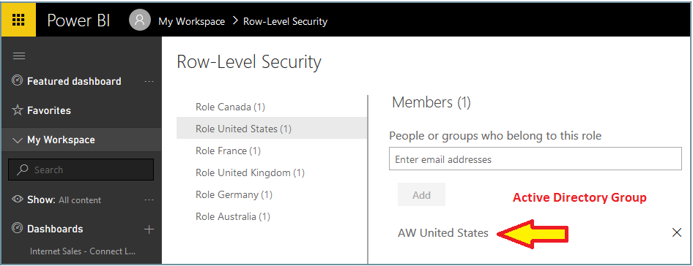
Power BI Service with Imported Data/Direct Query
Row-Level Security with Active Directory Groups

Slide 27
DEMO 6:
Power BI - Imported Data with Row Level Security
Power BI - Direct Query with Row Level Security

Slide 28
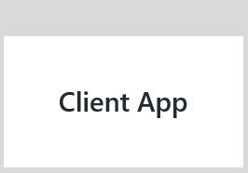
Client App (MVC, Web Forms, Web API) with SQL 2016 RLS
SessionContextInterceptor Class
EXEC sp_set_session_context @key=N‘LoginName', @value=@LoginName
dbo.DimCustomer
Name
Country
App User
Robin Alvarez
United Kingdom
Emily Miller houCorp.
United States
Cara Zhou
Germany
Security Policy
Row-Level Security based on SESSION_CONTEXT
EF SQL generated:
SELECT *
FROM DimCustomer

Slide 29
DEMO 7.1:
Client App Security (MVC, Web Forms, Web API) with SQL 2016 RLS and Active Directory.

Slide 30
DEMO 7.2:
Integrate Power BI dashboard with a web application

Slide 31
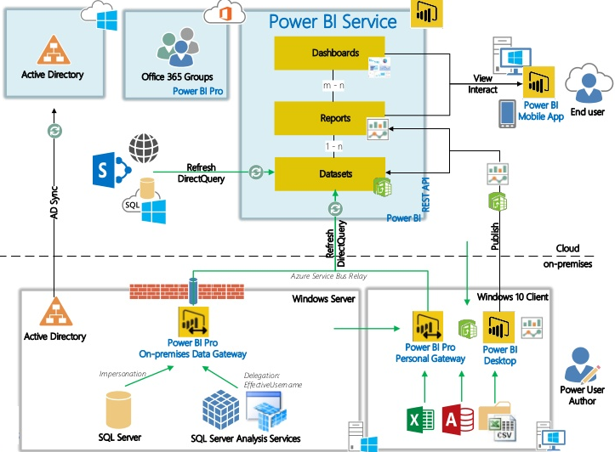
Power BI Architecture

Slide 32
Limitations of Power BI with RLS
At June, 2017:
Power BI Services
Q&A (Natural Language Search) is not available for Imported Dataset nor SQL Direct Query.
SQL Server 2016 RLS does not work for Power BI - SQL Direct Query.
Publish to Web does not have Authentication, so it cannot pass down the user for Row Level Security.

Slide 33
Resources:
www.hectorv.com – Category: BI Row Level Security
www.hectorv.com/...
I’ll write 6 posts on BI Data Security: Gateway, Azure AD, SQL RLS, SSAS RLS, Power BI RLS, Power BI Integration.
Microsoft Power BI security:
https://www.microsoft.com/en-us/trustcenter/security/powerbi-security
Power BI Security:
https://powerbi.microsoft.com/en-us/documentation/powerbi-admin-power-bi-security
Hector Villafuerte
Blog: www.hectorv.com
E-mail: optimumclick@gmail.com
Questions?

